Slide 1


The DHS is Gone – Now What?
Alternative Data Sources
Washington, DC
202-486-4997
welllworldsolutions@outlook.com
www.wellworldsolutions.com
Solutions for a better world
For:
Girls Not Brides
May 8, 2025

Slide 2

Agenda
Reasons for Child Marriage
Girls Not Brides’ ToC to Reduce Child Marriage
Metrics of Interest
The Current Problem
Alternative Sources of Data
What Next?
Assumption: Child Marriage is bad. Many studies have shown that over the years, including the 2017 World Bank’s Economic Impact of Child Marriage: Global Synthesis Report.
Notes:
So, we are going to focus today not on data that can be used to show the impact of child marriage on families, communities and nations, but we are just going assume that impacts are harmful, and focus on indicators that need to be tracked to assess reductions in child marriage and relevant contextual indicators.

Slide 3
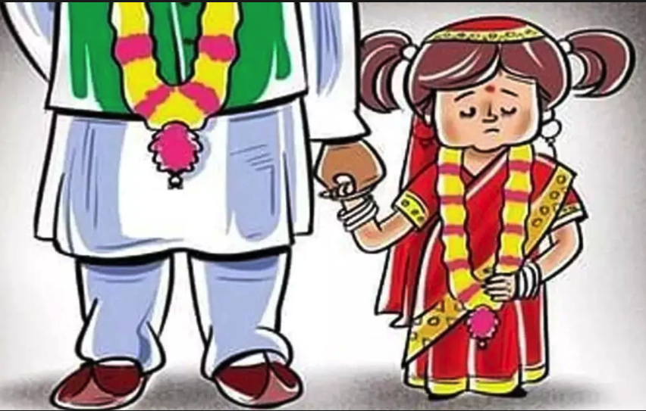
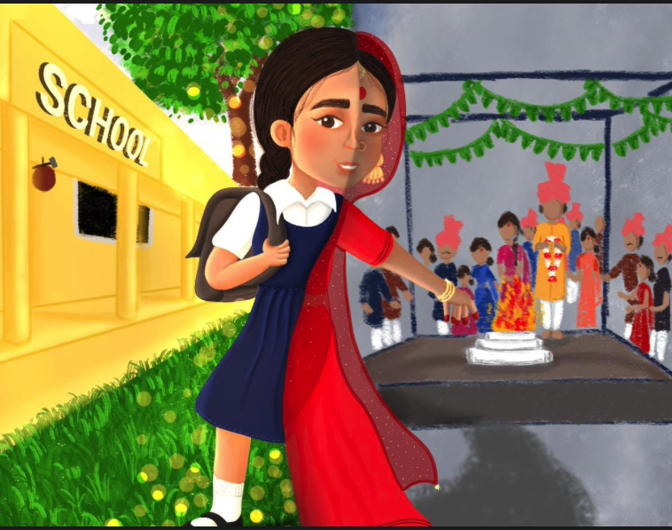
Reasons for Child Marriage
Social Norms: existing social norms that impede girls and women’s empowerment include:
  Age of Marriage; Decision-making; Freedom of Movement; Attitudes on women’s involvement in the economic, political and social spheres
Gender Inequality: discrimination in the following areas often contribute to child marriage:
  Ownership of assets; Control over incomes and assets; Engagement in productive labor (work for wage, trade, self-employment); Access to education (de-prioritization of girls’ education); Dowry/Bride price
  These data are usually not available nationally or sub-nationally. There is a need to collect data on these metrics to help inform strategy. UN’s Gender Social Norms Index provides some data, but lacks details. .

Slide 4
Reasons for Child Marriage
Poverty and Shocks: in hard economic times or during shocks, girls and women’s empowerment often declines and violence against them often increases.
Lack of Education: Due to de-prioritization of girls’ education, girls and women often have few resources to fall back on.
While DHS has been used in the past to track education and other relevant indicators, tracking poverty has always been more complex and few global datasets provide national or sub-national data tracking this information regularly – the UN’s Global Multidimensional Poverty Index is one source to consider for national-level statistics.

Slide 5
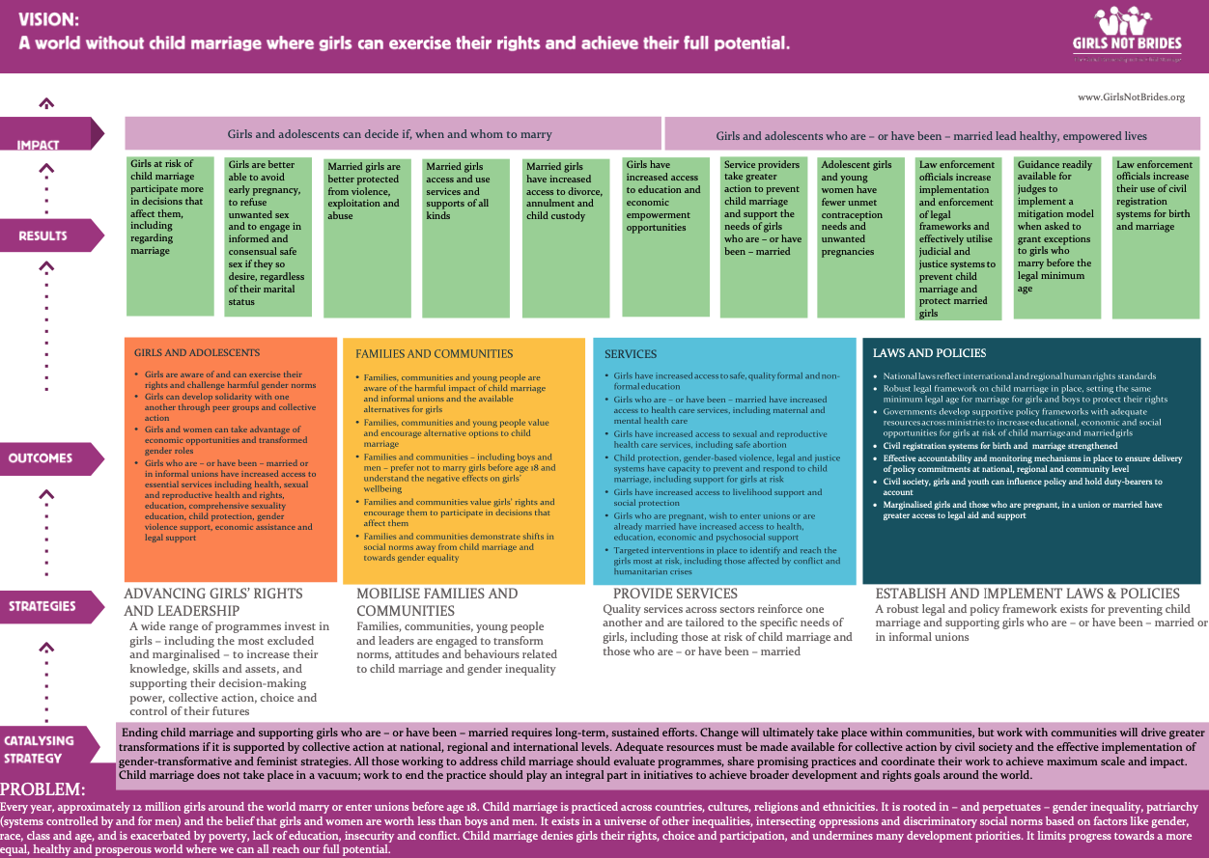
Theory of Change

Slide 6
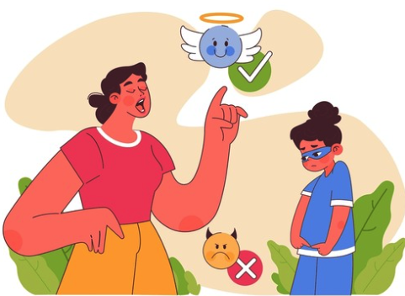

Drivers of Change
Drivers of change are contextual and vary across regions, nations and often also differing sub-nationally
Changes in societal norms, especially around gender roles, often drive changes in child marriage rates
Economic growth can relieve livelihood pressures and can allow for more girls and women to partake in the fruits of such growth with expanded educational and economic opportunities which can lead to declines in child marriage rates
Notes:
Drivers are contextual so the data needing to be tracked can be change from context to context; different societal norms may need to be tracked

Slide 7

Metrics of Interest: Impact Indicators
Percentage of Girls 15-19 Years Currently Married or in a Union
Percentage of Women 20-49 Years First Married or in Union by:
  Age 15 Years
  Age 18 Years
  Note: Typically measured for women 20-24 years of age.
Percentage of Women Currently in Polygynous Unions
Spousal Age Difference
Percentage of Women Directly Involved in Choice of First Spouse or Partner
Need More Real-time Data: Tracking new cases of marriage before age 18 years, but prevalence remains the more commonly used data.

Slide 8

Metrics of Interest: Outcome Indicators
Empowerment: Girls are aware of their rights and are able to take advantage of them
Norms: Families/Communities/Men are aware of harmful impacts of child marriage, are increasingly against it, and favor greater gender equality
Education and Access to Support Services: Girls have increased access to education, health care and other necessary services
Economic Opportunities: Girls/women are able to earn income and own assets
Violence Against Women: Reduction in familial and societal violence against women, physical, emotional, mental, financial and social
Laws and Regulations: Changes in laws and regulations that leads to greater gender equality and allow women to obtain education, earn incomes, own assets, marry at a later age, hold public or political office, and have access to legal representation

Slide 9
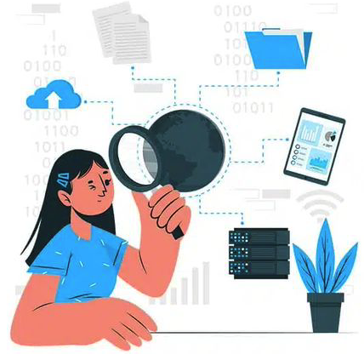
Data Sources
Program Data: Beneficiary data can be used to track changes in attitudes, opinions, norms, and in access to educational and economic opportunities, and access to healthcare and other services. Tracking these data allows for the continual assessment of impact on child marriage rates
Population-based Surveys: National and global population-based surveys (such as the former DHS) often provide data on both the impact and outcomes metrics of interest and can be used to track changes in these indicators
Administrative Data: Data from national and global programs can provide relevant data, such as child protection information services

Slide 10
Data Sources: UN Surveys
UNICEF’s Multiple Indicators Cluster Surveys: MICS has collected household data in 123 countries on the welfare of women and children. Includes data on education, marriage, fertility/birth, healthcare, sexual health, gender-based violence, maternal mortality, mental health, etc.
FAO’s 50X2030 Surveys: Focused on rural populations, these agricultural surveys are being planned and implemented with households in about 35 countries currently. Surveys are supposed to collect data regularly (potentially annually) and provide information on marriage, education, labor force participation, income and other key indicators of interest. A module of questions to measure women’s empowerment is increasingly being included in these surveys.
Notes:
ing.You know best what Program Data you have, and I am happy to help, if necessary, to identify metrics to collect and how to collect them. But today we will focus on secondary data sources still available that includes some of the indicators of interest.
Resilient Futures being an omnibus survey and still being in design phase, it is possible to still influence the modules of questions it asks and work with the World Bank to include metrics of interest to be regularly collected in these 16 countries. The World Bank is also interested in expanding to other countries, so opportunities exist to work with them to expand data collection. Other topics include climate adaptation, resilience, access to services, nutrition (dietary diversity, malnutrition), etc. They are open to customizing questionnaires by country, similar to the DHS.

Slide 11
Data Sources: World Bank Surveys
Living Standards Measurement Survey – Integrated Surveys on Agriculture: LSMS-ISA collected rostered data nationally every 3-4 years using a longitudinal panel in 8 African countries (Burkina Faso, Ethiopia, Malawi, Mali, Niger, Nigeria, Tanzania and Uganda). The roster asks about the marital status of each person over 15, the age at which they first got married, who the spouse(s) is/are, and if they live in the household. Survey also asks about education, labor force participation and income.
Resilient Futures: LSMS-ISA is transitioning to Resilient Futures. National longitudinal sample, rostered, omnibus survey collecting all of the above information PLUS data on women’s empowerment and other topics on a rotating basis. In-person data collection every 3 years with quarterly phone data collection for selected key indicators. Expanding from 8 to 16 countries – new countries are Ghana, Kenya, Nepal, Bangladesh, Cambodia, Indonesia, Honduras and Jamaica.
Find all WB, Country and DHS data at: https://microdata.worldbank.org/index.php/home
World Bank is looking for additional ways to fund data collection!
Notes:
.You know best what Program Data you have, and I am happy to help, if necessary, to identify metrics to collect and how to collect them. But today we will focus on secondary data sources still available that includes some of the indicators of interest.
Resilient Futures being an omnibus survey and still being in design phase, it is possible to still influence the modules of questions it asks and work with the World Bank to include metrics of interest to be regularly collected in these 16 countries. The World Bank is also interested in expanding to other countries, so opportunities exist to work with them to expand data collection. Other topics include climate adaptation, resilience, access to services, nutrition (dietary diversity, malnutrition), etc. They are open to customizing questionnaires by country, similar to the DHS.

Slide 12
Data Sources: Norms Surveys
Barometers: These national, cross-sectional, population-based surveys provide data on opinions, attitudes and norms, including on gender issues. Also includes demographic information on the respondent, including education, and on household assets. Barometers include:
  Americas Barometer
  Latinobarometro
  Asian Barometer
  Afrobarometer
  Arab Barometer
  Caucasus Barometer
  Eurobarometer
  Global Barometer
  World Values Survey
  Data also available from Gallup World Poll and Pew Global Attitudes Survey
Notes:
You know best what Program Data you have, and I am happy to help, if necessary, to identify metrics to collect and how to collect them. But today we will focus on secondary data sources still available that includes some of the indicators of interest.

Slide 13
Data Sources: Other Surveys
National Census and Other Data Collection Efforts: Many countries conduct national censuses, usually every 10 years, and sometimes engage in interim data collection efforts to measure key indicators of well-being such as poverty levels, education, labor force participation, among others.
Equal Measures 2030: Tracks the SDG Gender Index in 139 countries.
Notes:
You know best what Program Data you have, and I am happy to help, if necessary, to identify metrics to collect and how to collect them. But today we will focus on secondary data sources still available that includes some of the indicators of interest.

Slide 14
Data Sources: Administrative Data
Child Protection Services: Enforcement data from national child protection services, sometimes compiled by organizations such as the UNICEF, UNHCR or Save the Children and other NGOs, can potentially provide tracking data.
Child Trafficking Data: These data sources, which also track sexual trafficking/exploitation could also be used to track changes in key metrics.
National Birth and Marriage Registers: Data from these sources can help track key indicators of age at marriage.
Notes:
You know best what Program Data you have, and I am happy to help, if necessary, to identify metrics to collect and how to collect them. But today we will focus on secondary data sources still available that includes some of the indicators of interest.

Slide 15
Data Sources: Laws and Regulations
In order to reduce child marriage, another key route of interventions are enacting laws that will help level the playing field for girls and women. Data on these include:
  World Bank’s Women, Business and Law Data
  UN Women Global Gender Equality Constitutional Database
  UN Women’s Transparency Portal
  FAO’S Gender-Lex
  Women’s Rights, Recommendations and Compliance Database
  OECD’s Social Institutions and Gender Index (laws, social norms and practices in 179 countries)
  Our World in Data on women’s rights
Notes:
You know best what Program Data you have, and I am happy to help, if necessary, to identify metrics to collect and how to collect them. But today we will focus on secondary data sources still available that includes some of the indicators of interest.

Slide 16

Questions
  THANK YOU!!!
  Contact:
  Mousumi Sarkar
  wellworldsolutions@outlook.com
  www.wellworldsolutions.com
Notes:
You know best what Program Data you have, and I am happy to help, if necessary, to identify metrics to collect and how to collect them. But today we will focus on secondary data sources still available that includes some of the indicators of interest.

