Slide 1



Assessing Recall in Surveys Using Cognitive Interviews: Testing in Two Surveys Across 8 Countries
Washington, DC
202-486-4997
welllworldsolutions@outlook.com
www.wellworldsolutions.com
Solutions for a better world
Mousumi Sarkar, Well World Solutions
Julie de Jong, ICF International
Conducted for:
USAID’s Office of Education and
2025 American Association for Public Opinion Research (AAPOR) Annual Conference
St. Louis, USA
May 2025

Slide 2
Overview
Overview of two studies
The challenge of recall
Testing recall
Findings
Takeaways

Slide 3
Purpose of the Research Studies
 | Workforce Outcomes Reporting Questionnaire (WORQ) | Feed the Future Zone of Influence (FTF-ZOI) Assessment Survey
Sponsor | Developed for USAID’s Office of Education’s Youth Workforce Development Programs | Developed for USAID’s Feed the Future Assessment Survey
Purpose | Measuring employment and earnings among youth | Measuring participation in FTF type programs and experiences on climate change and adaptations in the ZOI
Definitions | Employed is at least working 1 hour for pay or profit in time frame. Earnings can be money or in-kind.
Notes:
# of youth who were not employed but are currently employed; ad # of youth who were employed before and who have higher earnings now (better employment).

Slide 4
The Challenge of Recall
Recall assessment of BLS’ Consumer Expenditure Interview Survey shows recall effects on reporting expenditure is greatest for irregularly purchased items and recall is significantly higher for the first month (Steinberg et al, 2006).
Study of self-employed households in coastal India demonstrate that recall error increases over time as respondents resort to inference; and those with higher earnings have better recall (Nicola and Gine, 2013).
An analysis of SIPP data after re-design showed lower recall on job and program participation endings when timeframe increased from 4 months to 1 year (Ellis and Chenevert, 2016).
Farmers report higher quantities of harvest, labor and fertilizer inputs and fewer plots as recall period increases (Wollburg et al, 2021)
Notes:
Decent versus Vulnerable work or Standard versus Non-standard work? Does getting paid in chickens count? ILO definition calls for having worked for pay or for profit for at least 1 hour within a specified time span. Is the 1 hour necessary? What does pay or for profit mean.
Recall bias – those working irregular hours, in non-standard work or those who are self-employed are particularly prone to recall bias and have difficulty reporting hour works or amount earned accurately. This is particularly true for youth. Also research has shown that current circumstances may influence recall.
Decision was to use LSMS as base.
Several instruments measure these concepts in OECD countries such as the European Working Conditions Survey, but there has been little work done in the developmental economy context on these concepts.
Differences in not just terms but also in understanding of concepts (example, interpreting last month).

Slide 5
About WORQ
Study Details | Workforce Outcomes Reporting Questionnaire (WORQ)
# of Interviews | 107 cognitive interviews (52 males; 54 females and 1 other) in 5 countries in 5 languages – additionally, 261 exit interviews were conducted in 2 countries during the piloting of the survey
Location | 5 countries – Philippines, Kenya, El Salvador, Rwanda and Kyrgyzstan
Challenge | Recall of employment and earnings – how far back can youth remember and accurately report?
Notes:
# of youth who were not employed but are currently employed; ad # of youth who were employed before and who have higher earnings now (better employment).

Slide 6
Key Conceptual Challenges -- WORQ
Inconsistency in Definitions – what constitutes as employment; minimal number of hours required; types of pay to include.
Respondents had difficulty with several terms such as temporary versus permanent versus seasonal work; whether to include some activities as work; and difficulty calculating number of days or hours they worked.
Our focus for this presentation is, however, on RECALL
Recall Bias –people, especially, those working irregular hours or multiple jobs, have difficulty recalling employment and earnings information accurately or including all the jobs in which they work
Notes:
Decent versus Vulnerable work or Standard versus Non-standard work? Does getting paid in chickens count? ILO definition calls for having worked for pay or for profit for at least 1 hour within a specified time span. Is the 1 hour necessary? What does pay or for profit mean.
Recall bias – those working irregular hours, in non-standard work or those who are self-employed are particularly prone to recall bias and have difficulty reporting hour works or amount earned accurately. This is particularly true for youth. Also research has shown that current circumstances may influence recall.
Decision was to use LSMS as base.
Several instruments measure these concepts in OECD countries such as the European Working Conditions Survey, but there has been little work done in the developmental economy context on these concepts.
Differences in not just terms but also in understanding of concepts (example, interpreting last month).

Slide 7
WORQ Approach to Testing Recall
First round of testing revealed recall to be a significant issue
In subsequent rounds, we specifically probed on recall including gathering information on time-period they are reasonably able to recall accurately and why.
Questions on recall were asked during each item as appropriate
A series of questions on recall were specifically included in the debrief questions at the end of the cognitive interviews and in exit interviews after the initial phase of the test/retest pilot.

Slide 8
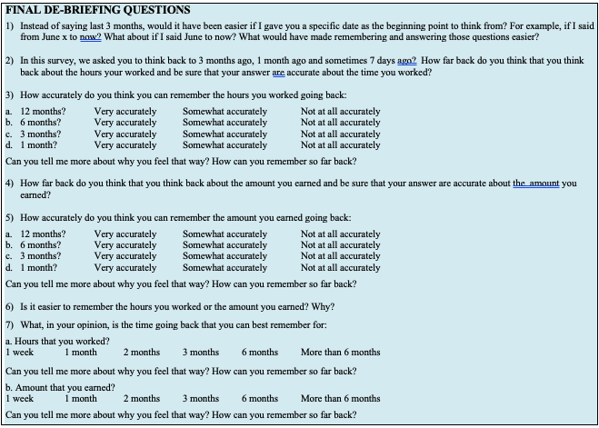
Our Approach to Testing Recall – Debrief Questions (WORQ)

Slide 9
Recall Challenges – WORQ
Initially asked for “past 3 months”. Respondents…
  Often forgot to include secondary employment, such as selling items or working for pay on one-off or sporadic projects – for example, one respondent forgot to include drawings she was selling; other forgot to include productive hours use to run their home-businesses such as selling cell phone minutes.
  Working irregularly often had difficulty remembering if they worked a specific month in the past 3 months time period and how many hours they worked then or how much they made – many had worked 2 days in one month, one day in another month and were unsure if those periods of employment fell within the specified time-frame.
  Often counted the 3 months differently – one respondent identified 3-months to be 90 or 91 days, but then said it comprised of two months (June and July) and left out the month immediately before the survey or the survey month.’
First round testing in the Philippines indicated: 1) need for anchoring; 2) preference for shorter time-period; and 3) need for separating wage-related questions by employment type.

Slide 10
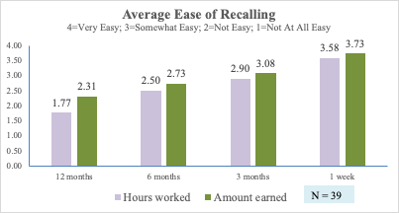
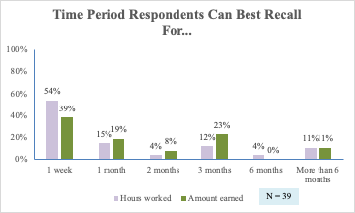
Recall Ability – WORQ
In subsequent rounds of testing in Kenya and El Salvador we asked more detailed debrief questions on recall over the 3-month time period.
Respondents were evenly divided on their ability to recall hours worked versus amount earn.
Ability to recall earnings is slightly better over longer time periods compared to hours worked.

Slide 11
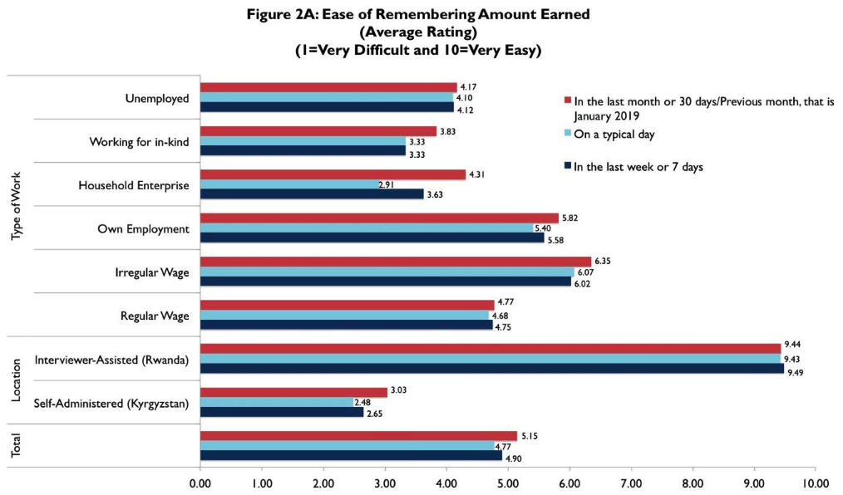
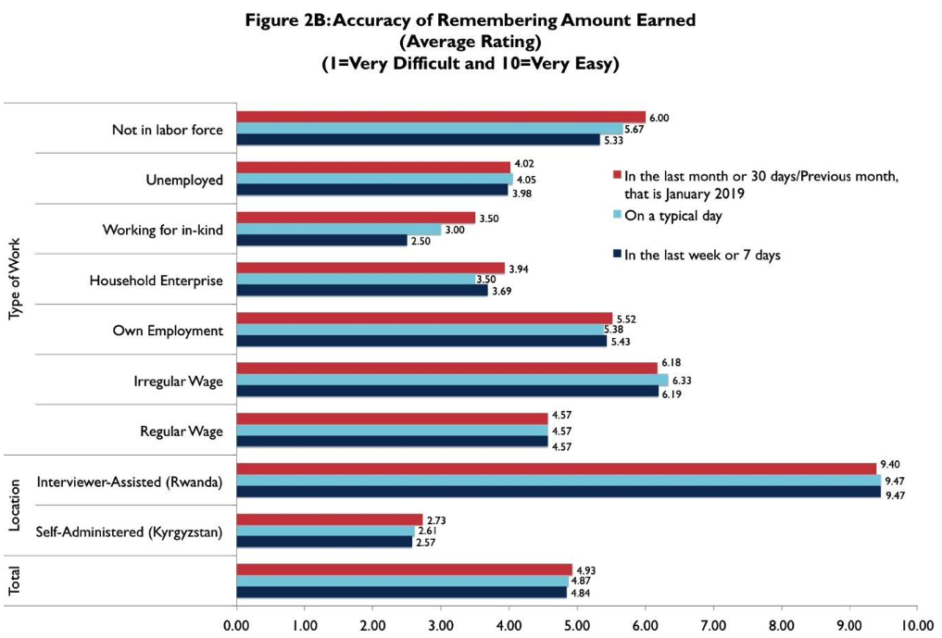
Recall Ability – WORQ (Earnings)
Exit interview data from pilot testing in Kyrgyzstan and Rwanda show respondent’s self-rated ease and accuracy of recall (N=261).
The 1 month or 30 day period of recall seems to be best for earning information across different types of employment status.
Interviewer-assisted data collection yielded better data.

Slide 12
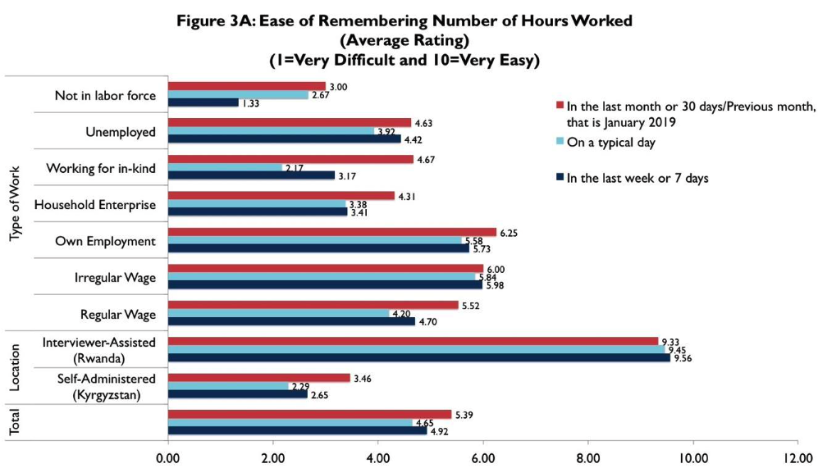
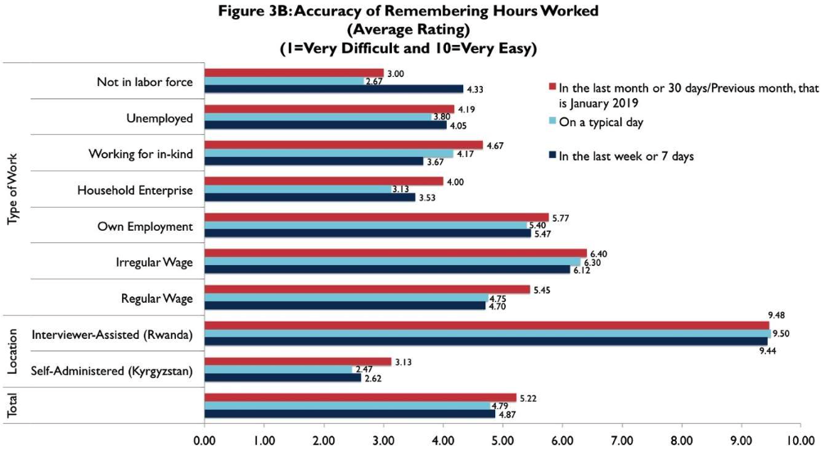
Recall Ability – WORQ (Hours)
Exit interview data from pilot testing in Kyrgyzstan and Rwanda show respondent’s self-rated ease and accuracy of recall (N=261).
The 1 month or 30 day period of recall seems to be best for hours worked information across most different types of employment status – for those in irregular employment or those working on their own business, last 7 days worked just as well.

Slide 13
WORQ – Resolution
Employment: Ask about last month, using anchoring date
Earnings:
  Regular/Permanent: Usual take home pay and time pay covers; and usual days and hours worked
  Temporary/Irregular: Number of days worked in last week or previous month; number of hours last worked at job; amount earned in last month
  Own Employment: Number of days and hours worked in a typical week; and earnings in last week or month
Details from validity and reliability testing, and final instrument and guidance are available at: https://wellworldsolutions.com/the-workforce-outcomes-reporting-questionnaire-worq/

Slide 14
About FTF-ZOI
Study Details | Feed the Future Zone of Influence (FTF-ZOI) Assessment Survey
# of Interviews | 102 (51 men and 51 women) in 3 countries in 16 languages
Testing | In 3 countries – Mali, Kenya and the Democratic Republic of Congo (DRC)
Challenge | Recall – are residents in ZOIs able to accurately report program participation and climate adaptation practices for themselves and their household members?
Changes | The questionnaire was revised slightly after testing in Mali and then tweaked further after testing in Kenya. A standard set of questions was developed for the Program Participation module for the new round of testing beginning with DRC (this module was customized by country in previous rounds); and significant changes were made to the Climate Adaptation module prior to the testing in DRC. Debrief questions on recall were included in DRC for the first time.
Notes:
# of youth who were not employed but are currently employed; ad # of youth who were employed before and who have higher earnings now (better employment).

Slide 15
Recall Challenges – FTF-ZOI
In the FTF-ZOI surveys, respondents are often asked to report experiences for the last 12 months and sometimes longer time periods, and not just for themselves but also for others in their household.
  Are respondents able to remember agricultural practices they implemented and programs they participated in over the last 12 months?
  Are respondents able to report not just for themselves but also for other members of their household?
  When it comes to recalling experiences, are respondents able to respond based on the time-frame provided?
Notes:
Mention that this assumes they understand the nature of the program in question in the first place.

Slide 16
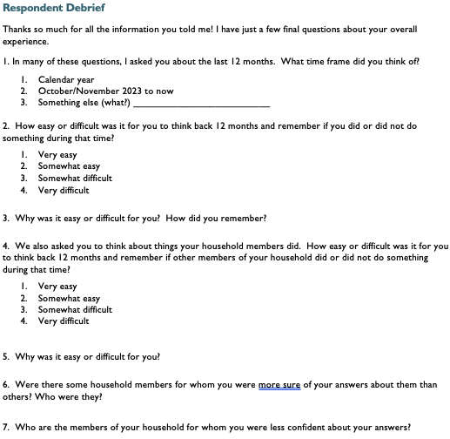
Our Approach to Testing Recall – Adapted Debrief Questions (FTF-ZOI)
Individual questions were also specifically probed for:
What time period they thought of when they answered the question?
Who they considered when they answered the question – just themselves or also other household members, and if they were unable to answer for specific household members.

Slide 17
Ability to Recall Implementing Practices
Mali
  Respondents noted they themselves or their wives had implemented specific practices and hence they remembered about them
Debrief questions on recalling activities 12 months in the past were included in subsequent rounds
Kenya
  18 of the 50 respondents said it was “very” (3) or “somewhat” (15) difficult to report activities over a 12-month period. “Somewhat long ago”; “might be too long to recall” were some reasons.
  Those finding it easy used anchoring points (elections) or reported that the recall period was short enough to be able to adequately recall
DRC
  8 of the 26 respondents said it was difficult to report activities over a 12-month period. It was hard to remember for every activity over that time period; “because there are so many things, every day there are new things”; “given my age and health conditions, which don’t allow me to think deeply”
  Respondents finding it easy said it was because it was part of their “every day life” or “every day problems”; they record activities in a notebook; and because it is not that long a time period.
Respondents are mostly able to report if they engaged in a practice in the last 12 months.

Slide 18
Ability to Recall About Household Members’ Activities
Mali
  Respondents noted they “mastered” their household; they were “aware of everything in my household”; “all household information doesn’t escape me” when asked how they knew about activities their household members’ engaged in
  Even on women’s activities, the mostly male respondents noted that their wives hide “nothing from me.”
Debrief questions on recalling household member activities were included in subsequent rounds
Kenya
  19 of the 50 respondents said it was “very” (4) or “somewhat” (15) difficult to report household member activities over a 12-month period. “Difficult to know what they were up to and activities they were undertaking.”
DRC
  7 of the 26 respondents said it was difficult to report household member activities over a 12-month period. “I have to consider each person in the household, which forces me to remember all the conversations I have had.”
  Respondents finding it easy said it was because they do everything together or “No one in the household does things without contacting me.”
Unclear if respondents truly are able to report on others or they just think they do; contextual differences may be at play.
Notes:
Mali – may speak to specific cultural context and may differ elsewhere.

Slide 19
Ability to Recall and Respond on Given Time Frame
Per responses to debriefing questions in Kenya and DRC: When asked about agricultural practices or programs they participated in, respondents often responded based on the seasons – sometime planting, sometime harvest – or use time periods (17 of 74). A few used the calendar year and not the actual 12 months (another 17 of 74). Fewer than half used the actual time period provided.
DRC : When asked about their experiences with the changing weather in the past 10 years, respondents sometimes responded based on the: last weather-related disaster, the last harvest season, the calendar years, and often random spans of time (2017-2020).
Notes:
Talk about Gates and experiment planned

Slide 20
Future Research on Recall
Further testing using calendars, reference points and other strategies were planned for in Liberia, but the demise of USAID kiboshed those plans.
Very recent work in Liberia and Rwanda will further explore use of tools to improve recall and results will be shared next year
Notes:
Talk about Gates and experiment planned

Slide 21
Thank you for listening!
Questions/Comments???
Please contact
Mousumi Sarkar at
wellworldsolutions@outlook.com
Or
Julie de Jong at jjosefos@umich.edu

